Slide 1
INSTRUCTION FOR ONLINE APPLICATION SYSTEM
(APPLICATION & RESULT)

Slide 2
APPLICATION

Slide 3
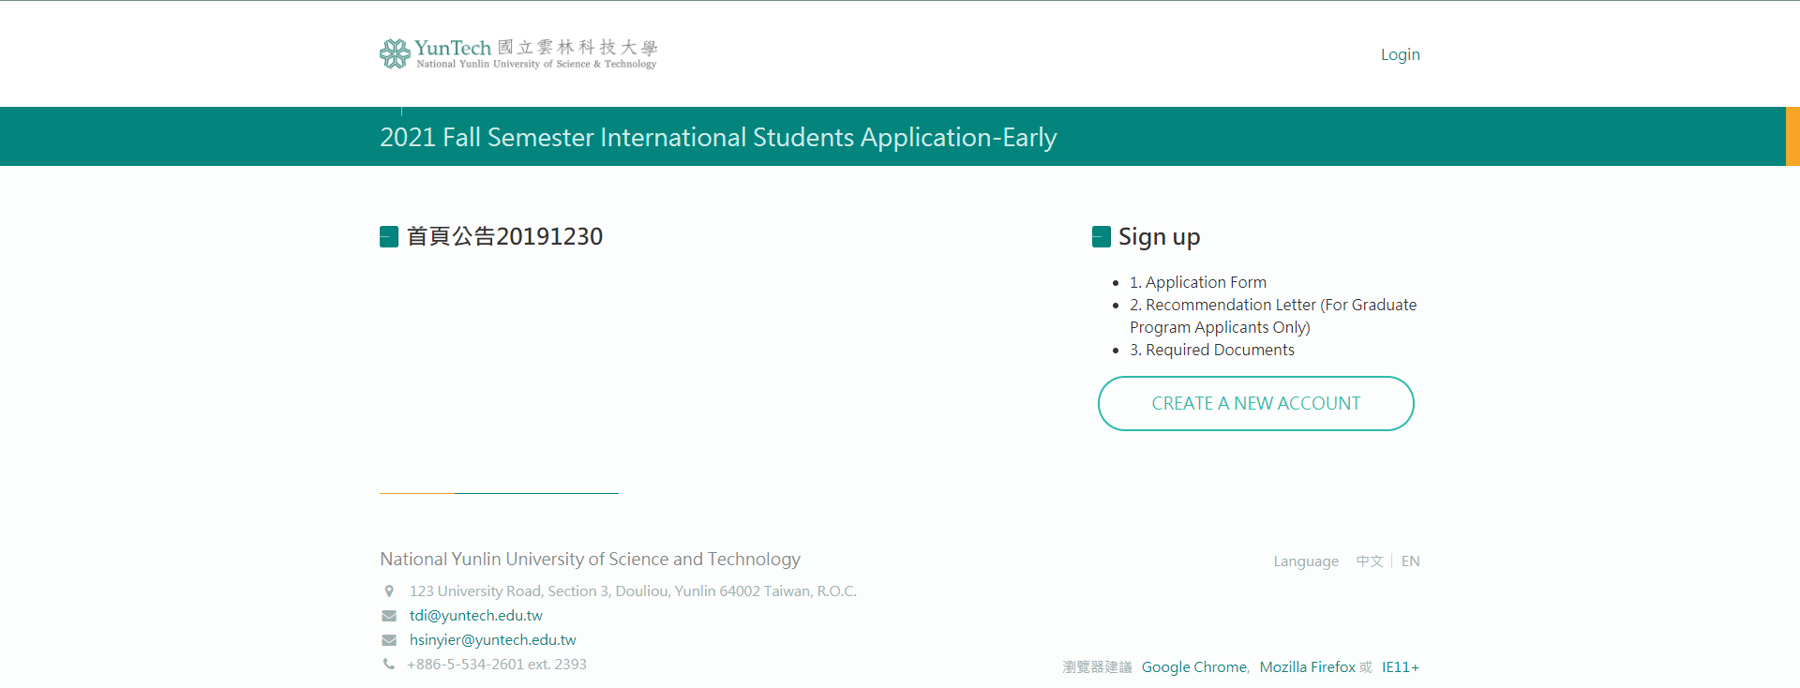

Slide 4
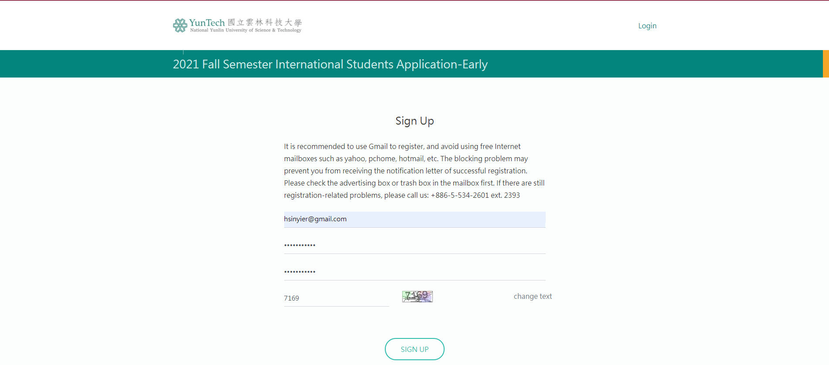
Fill in your email address
and the password first

Slide 5
Check your email

Slide 6
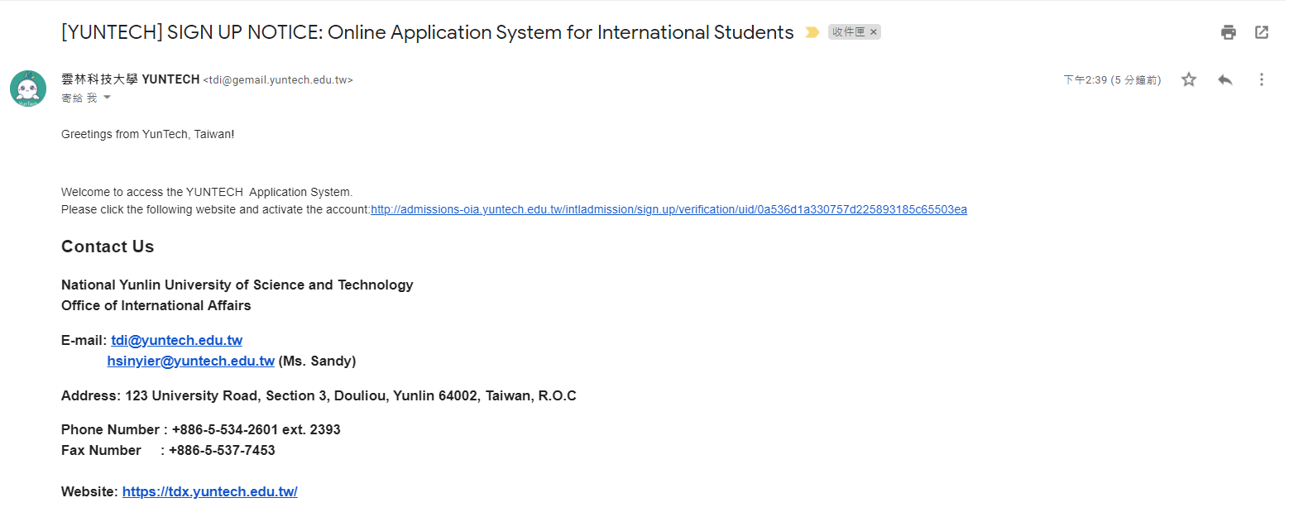
Click the link to activate your account

Slide 8
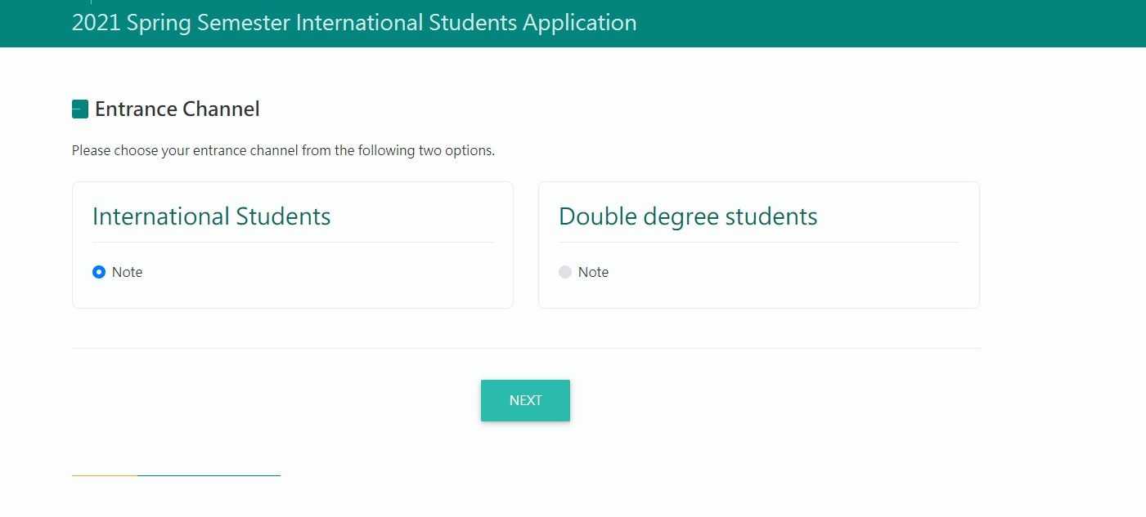
1
2

Slide 9
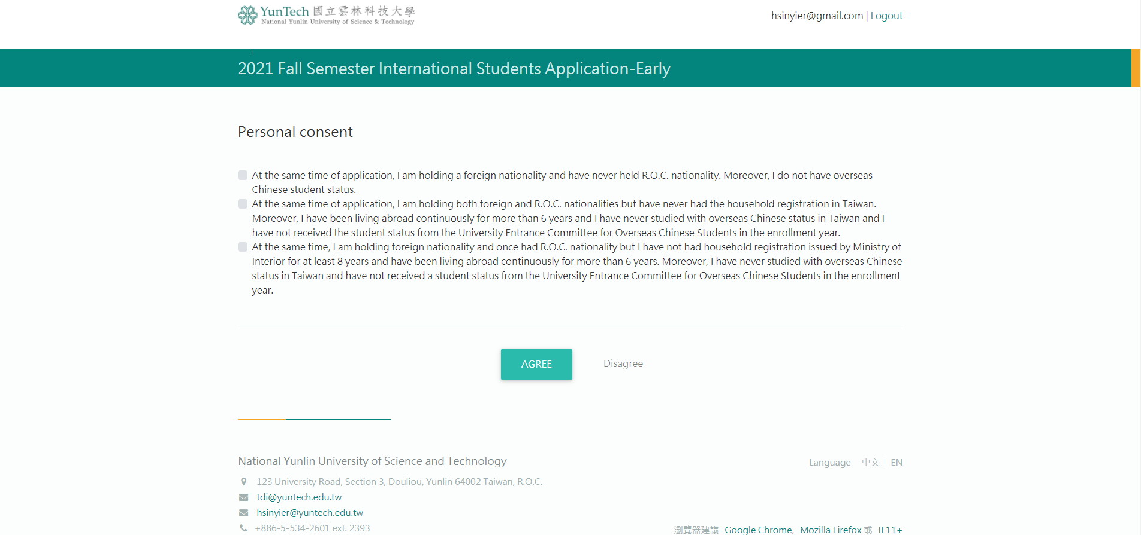
→
→
→
Tick the one you are qualified for

Slide 10
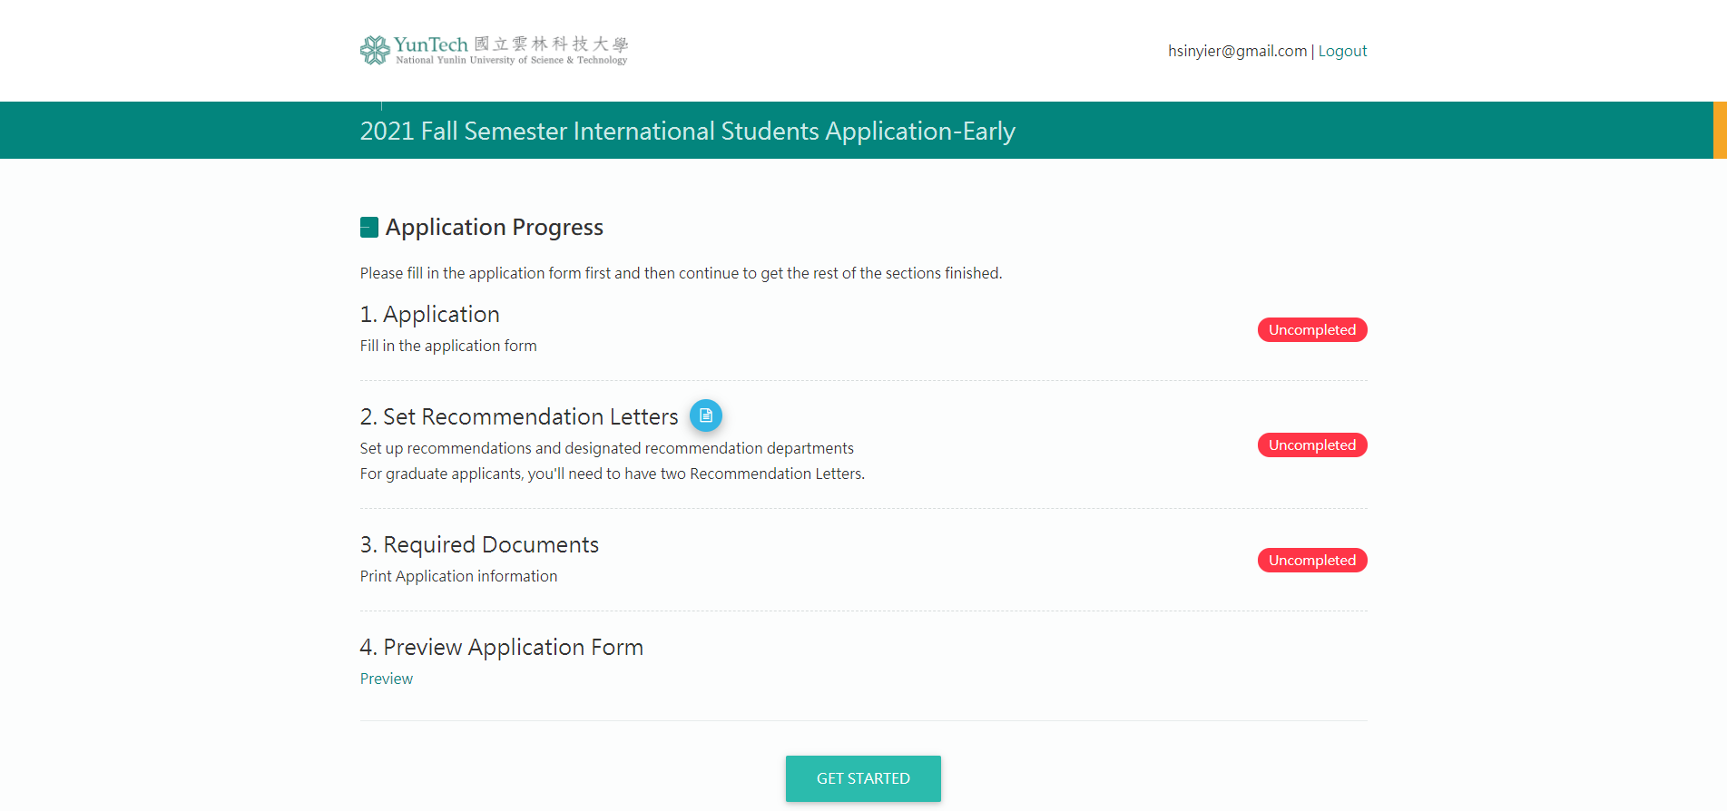
Condition of each progress

Slide 11
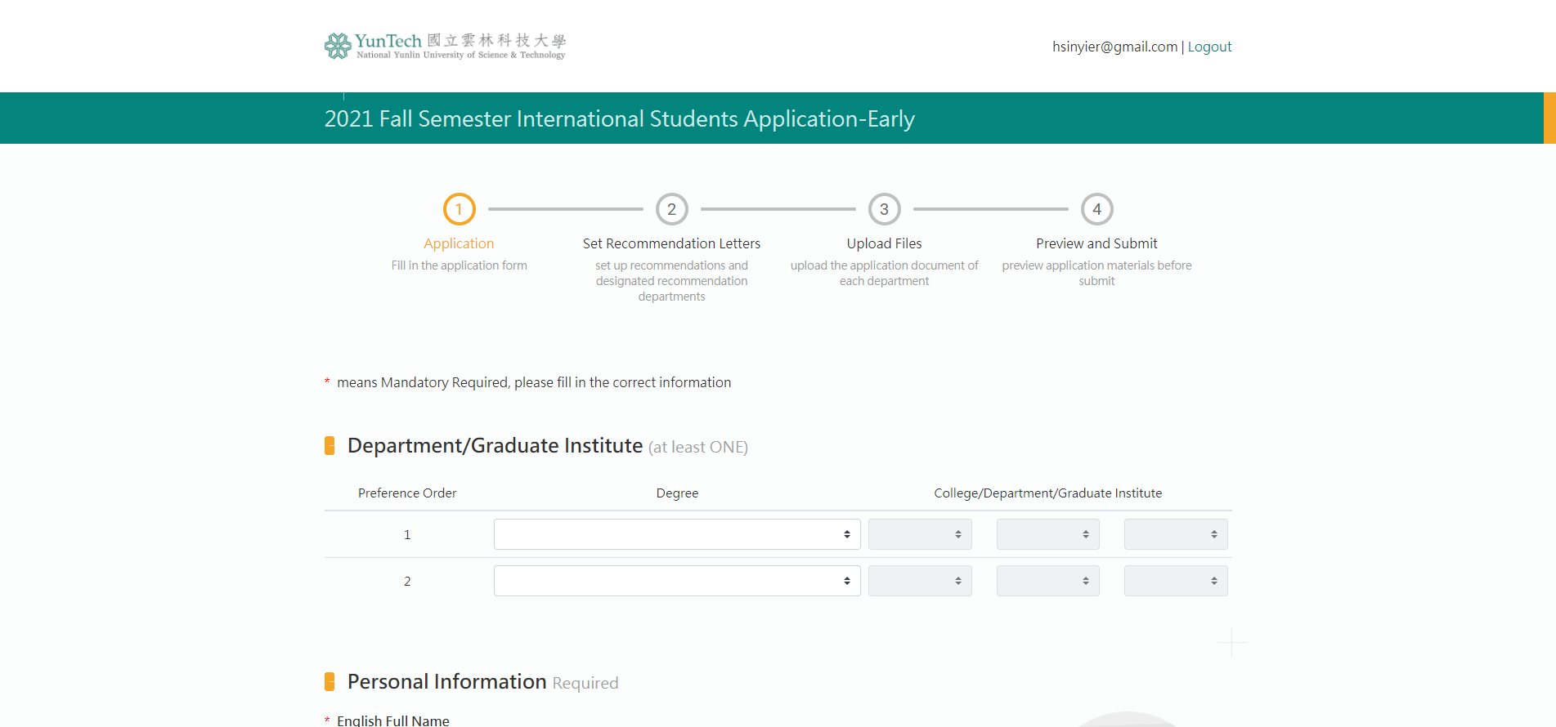

Slide 12
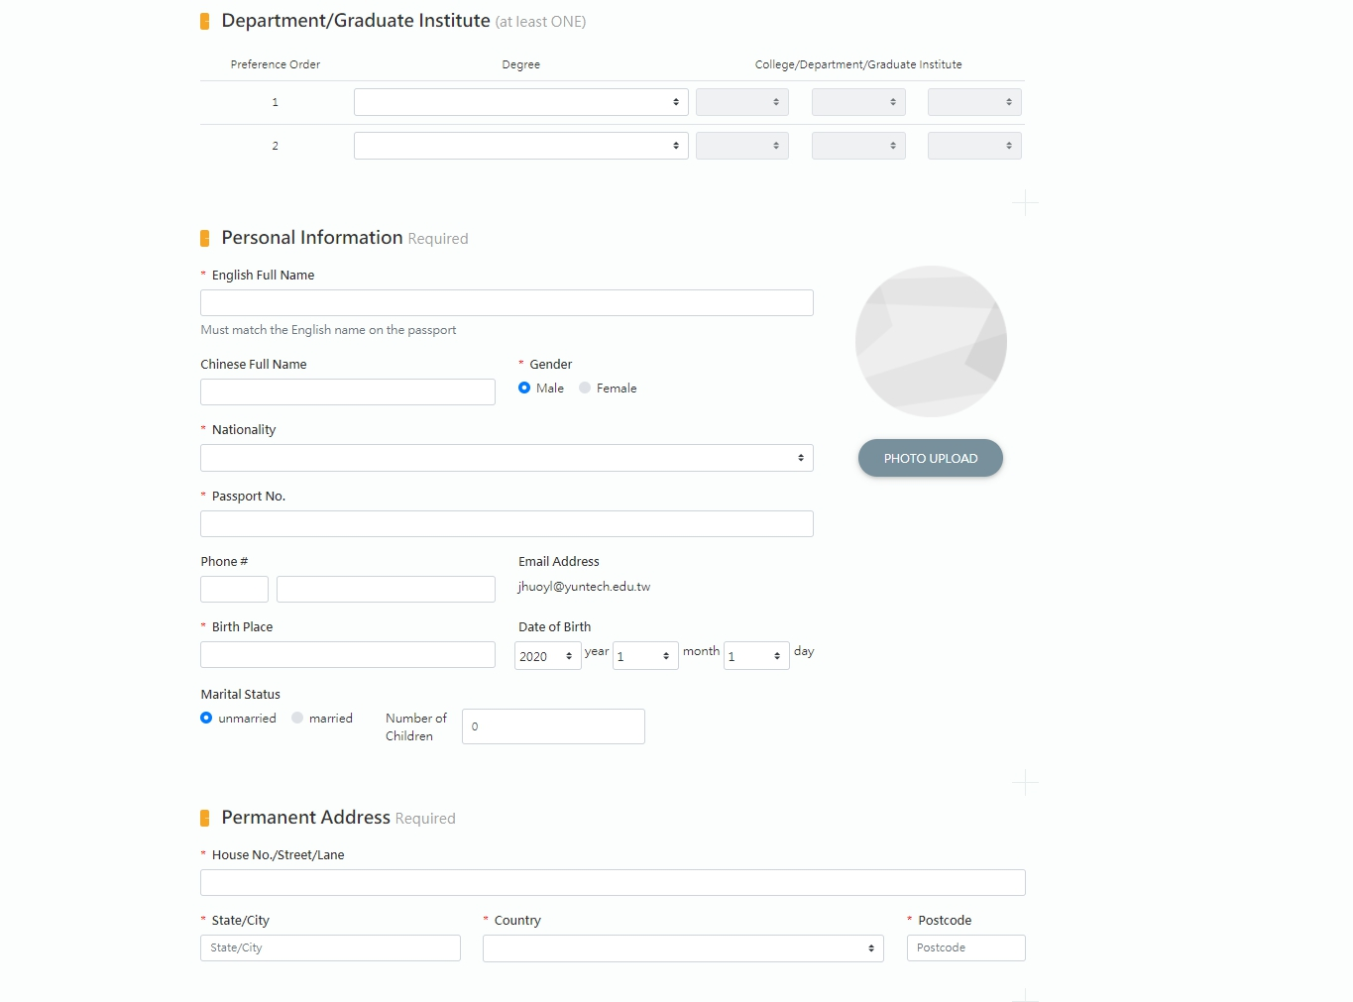
If you do not have Chinese name,
please just skip this one.

Slide 13
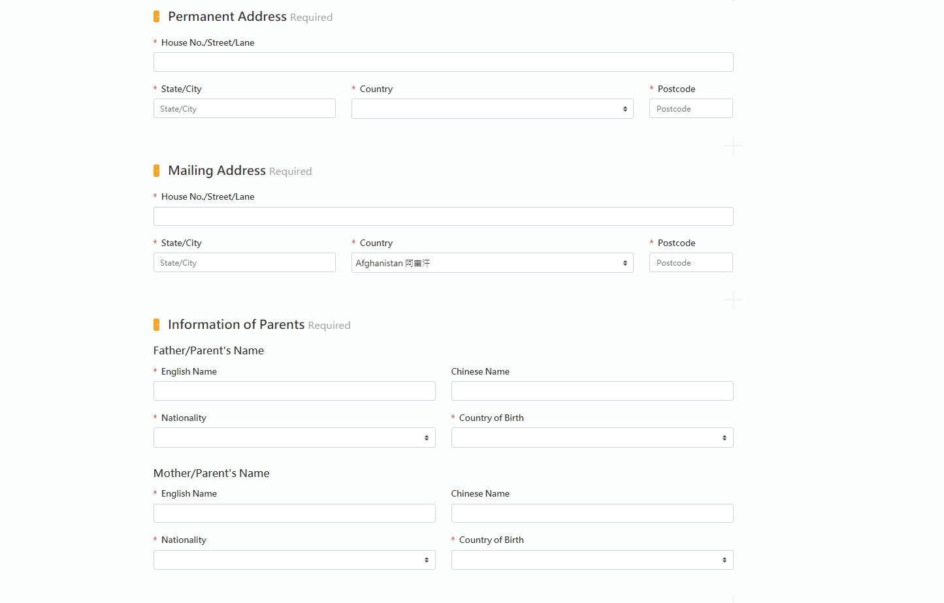
Please fill in as detailed as you can. The mailing address is for sending your hard copy of Letter of Acceptance.

Slide 14
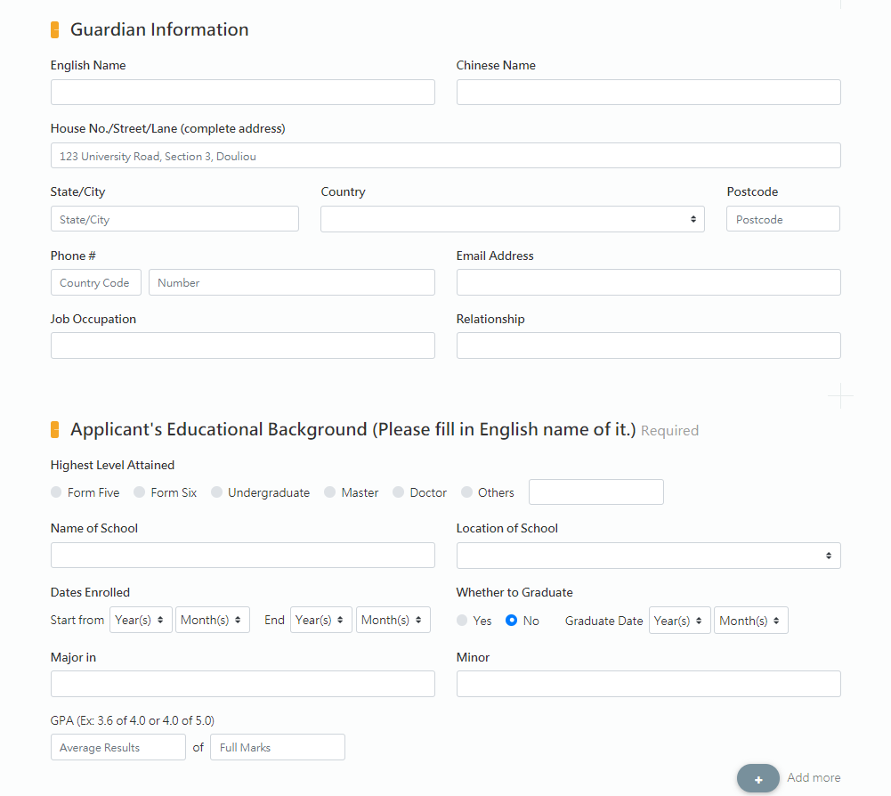
Please fill in the English name of your home school.

Slide 15
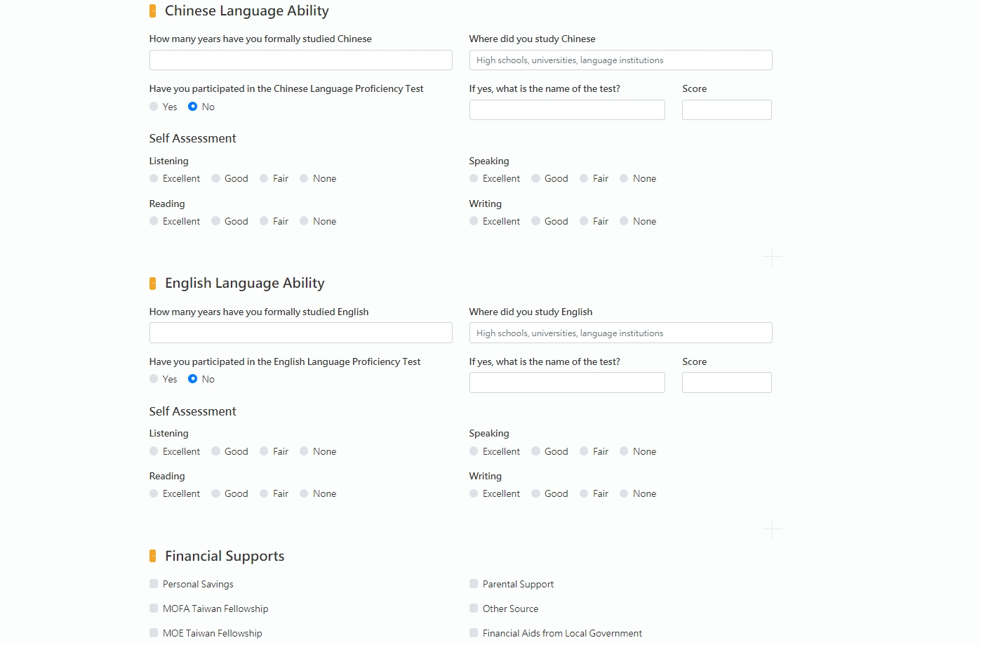

Slide 16
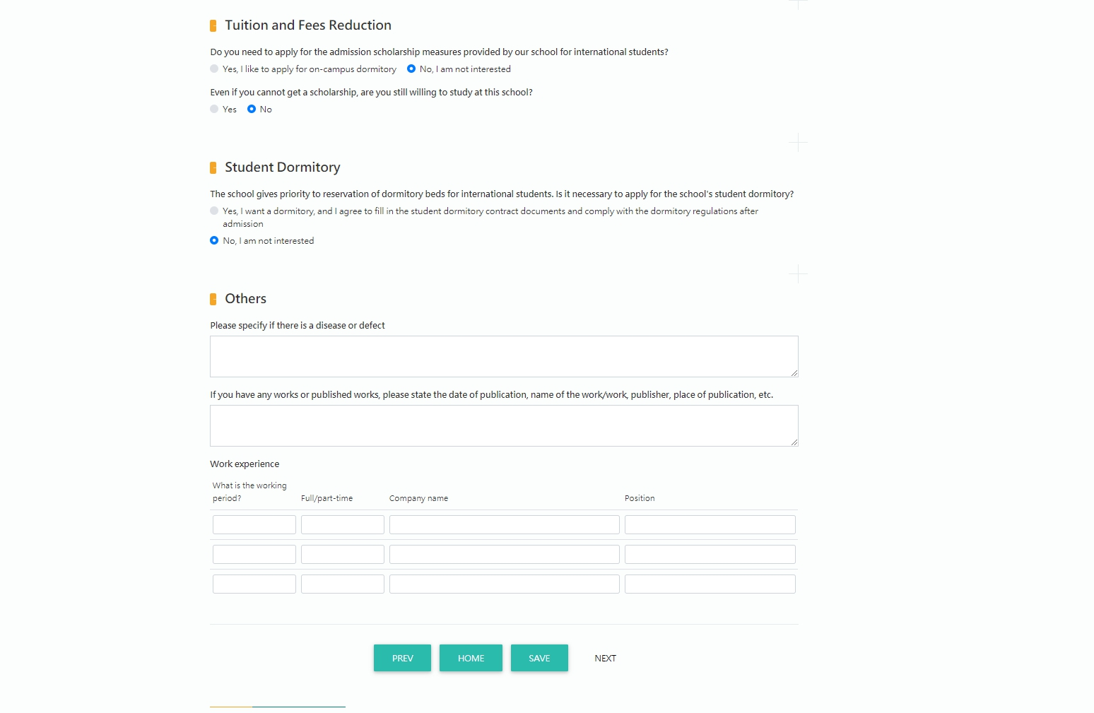
Please click save and then go to next page.
1
2

Slide 17
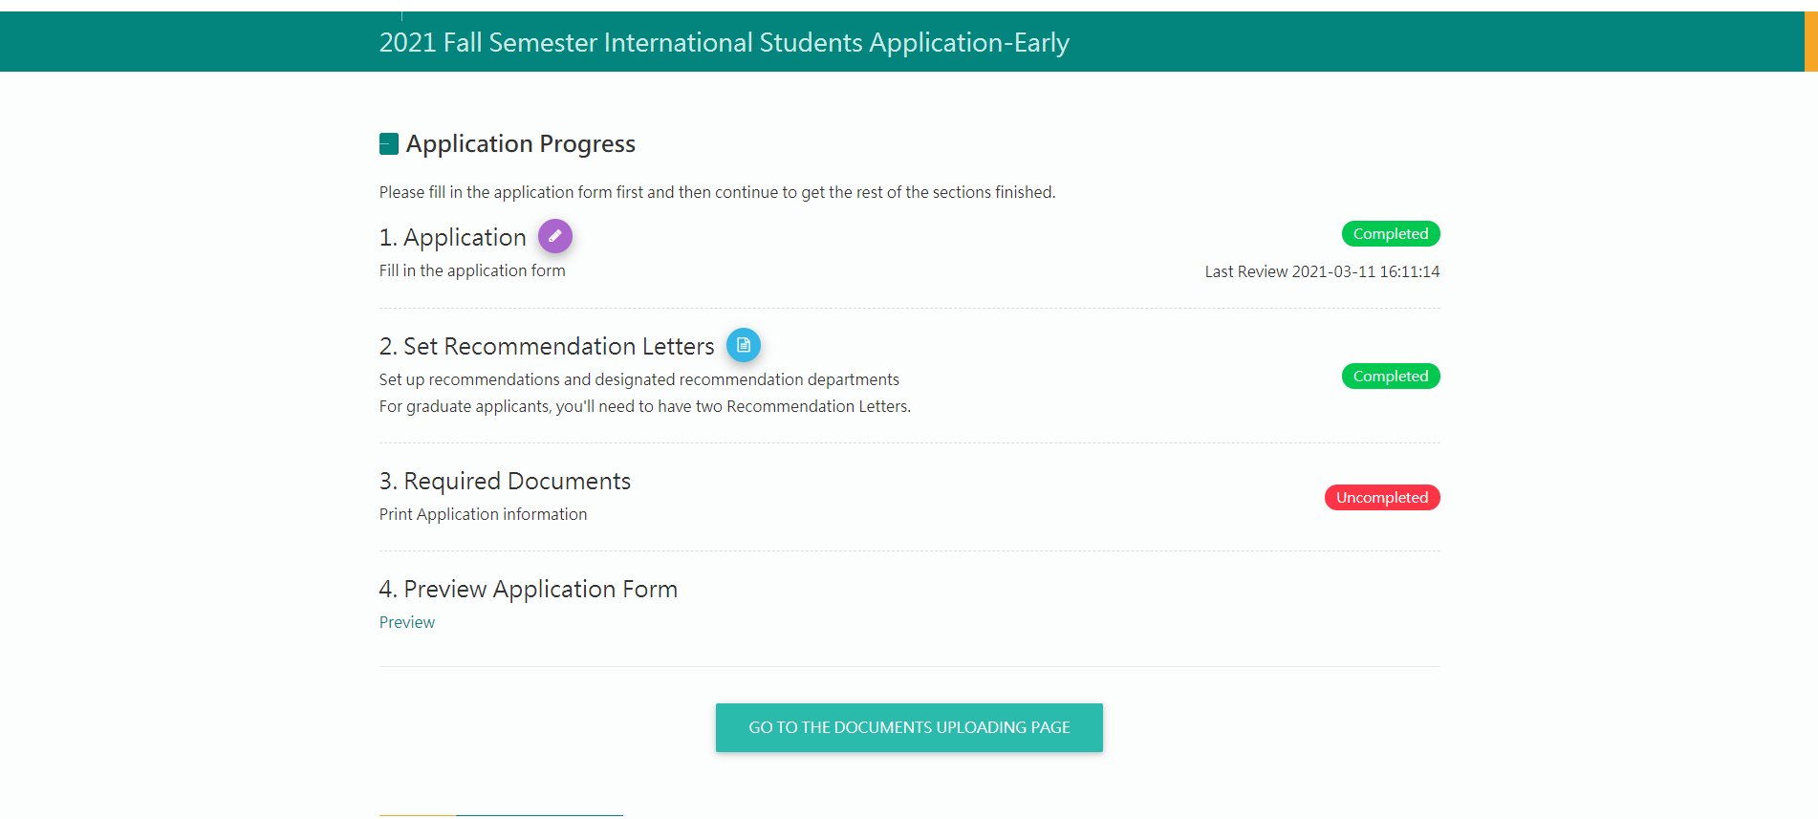
Click to set your referee

Slide 18
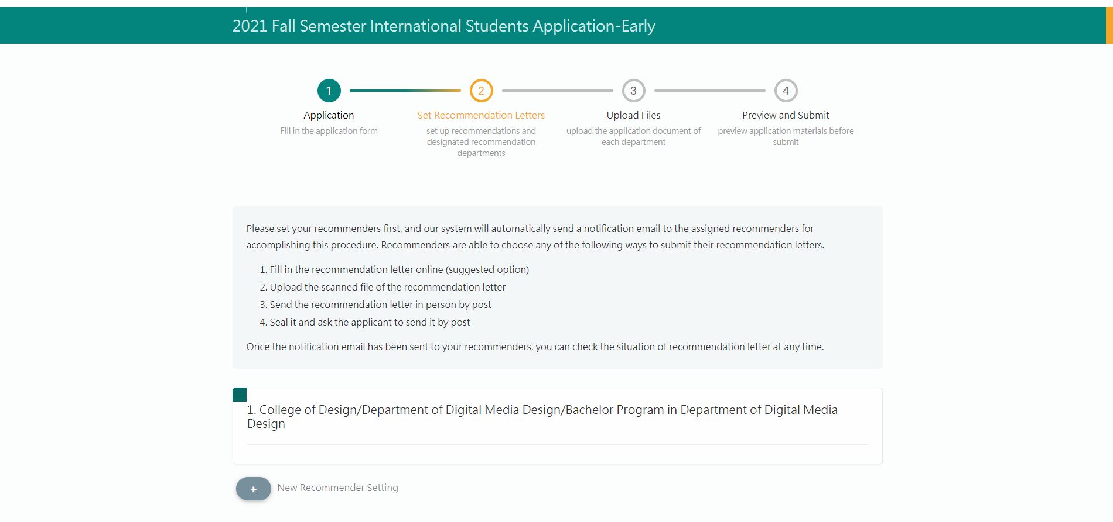

Slide 19
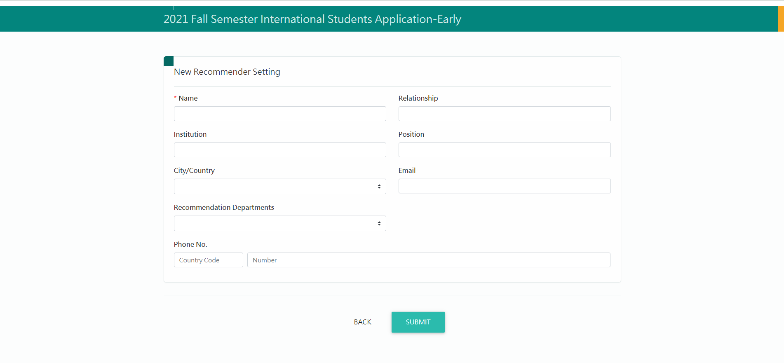
Make sure the email address is correct
Fill in the information of your referee and click submit, then the system will notify(via Email) your referee to complete the recommendation letter for you

Slide 20
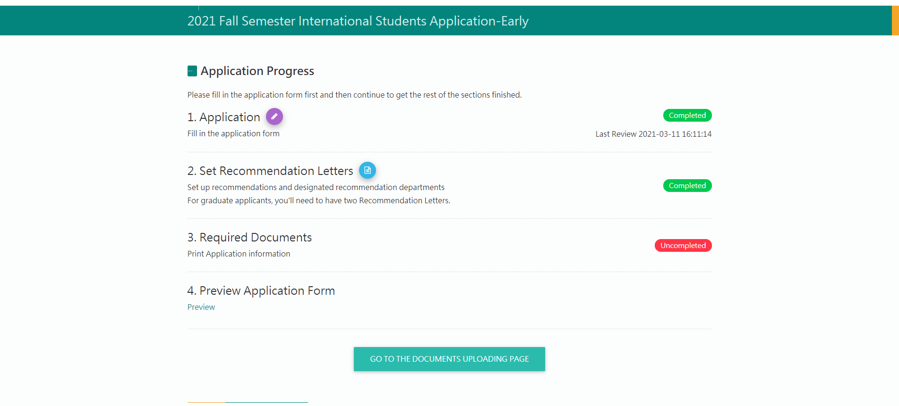

Slide 21
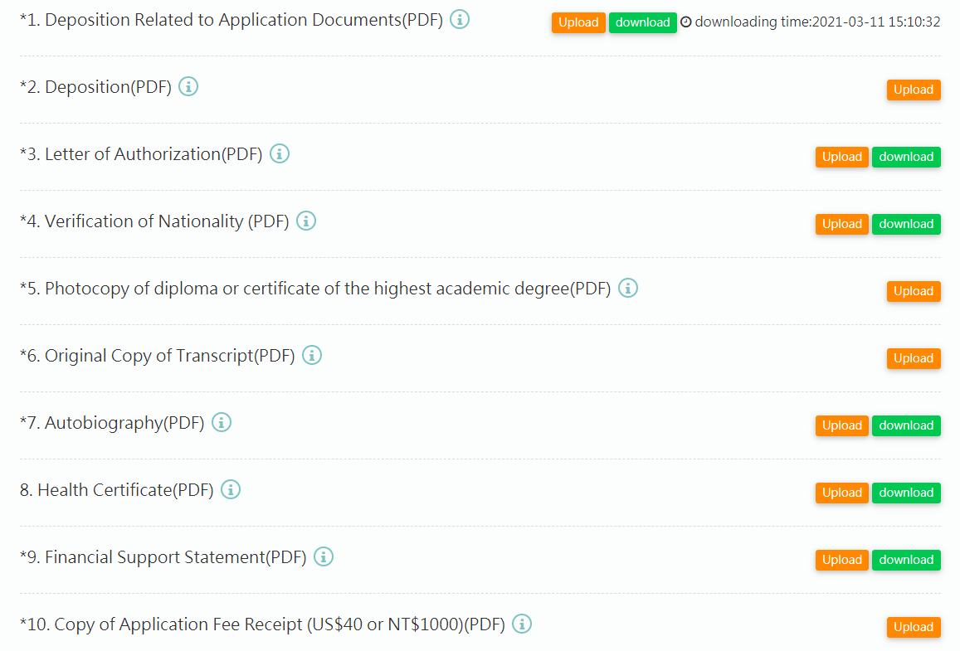
Download the sample/ form to make sure that you upload the correct documents
Upload all the required documents

Slide 22
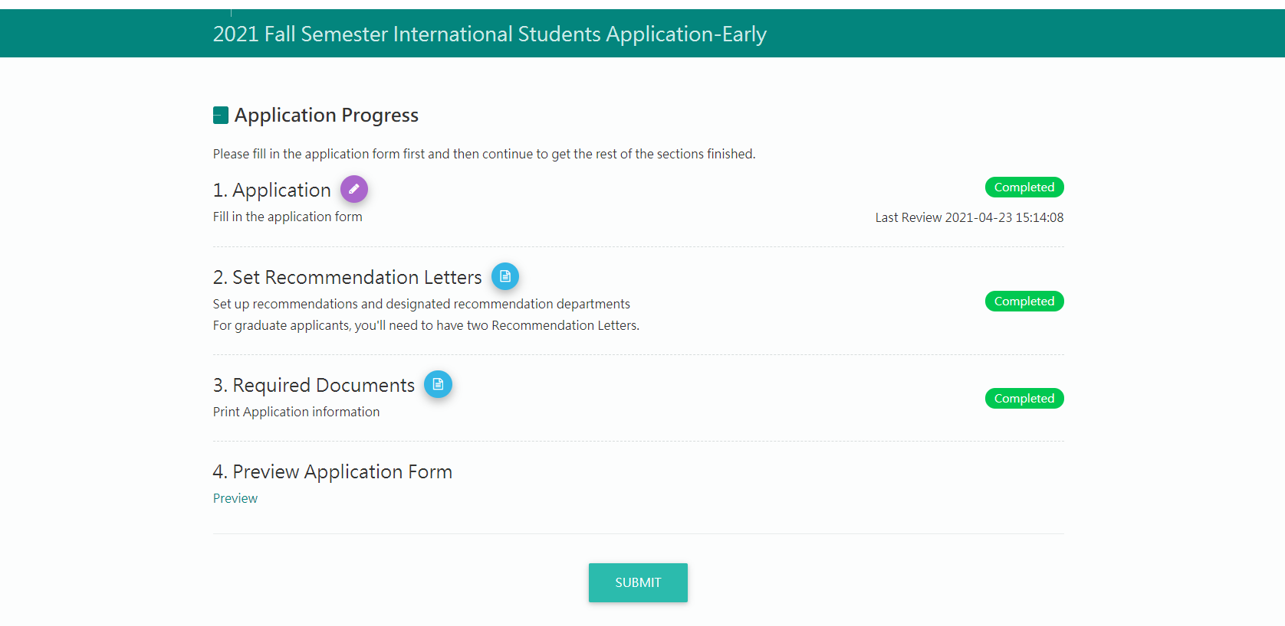
Click Preview to preview your application form
After everything is done, please remember to submit your application

Slide 23
RESULT

Slide 24
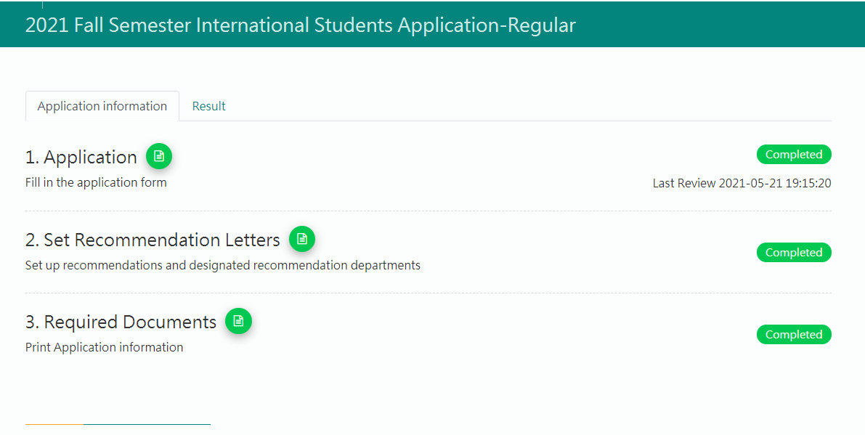
Click to check the result

Slide 25
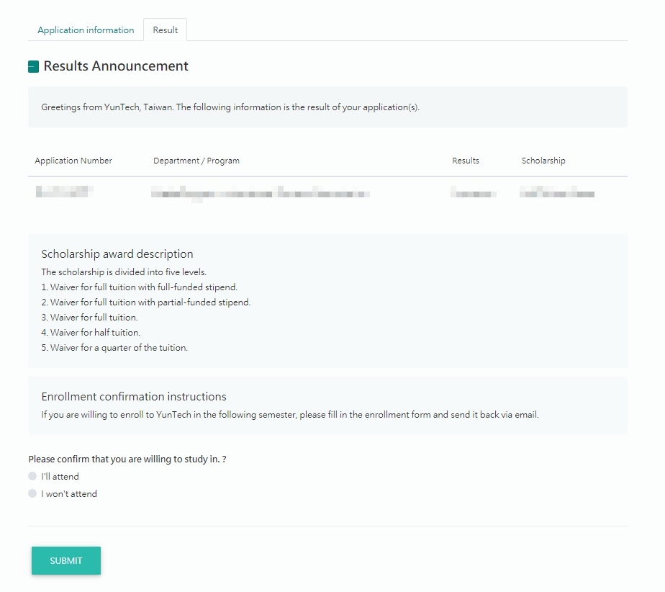
Result
Click to reply your willingness
If you are willing to enroll, please select the dept. and upload the filled enrollment form afterwards

Slide 26
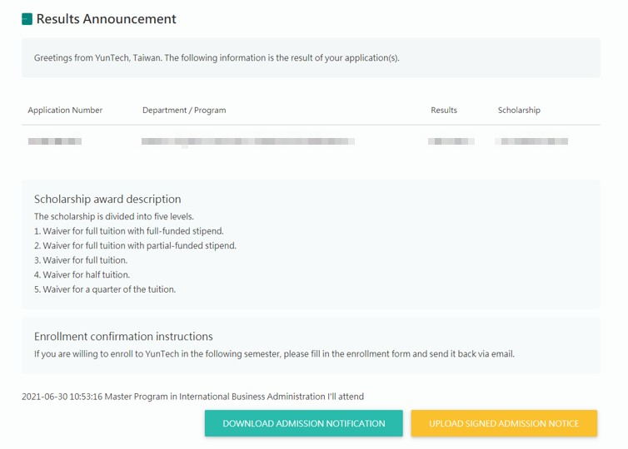
Step1
Step2

Slide 27
COMPLETE

